Slide 1
Limit Definition of a Derivative
For Steifel’s IB Mathematical Studies Class

Slide 2
What is a Limit
A limit is a value that a function or sequence approaches as the input or index approaches some value.
They are used to define the different types of continuity, derivatives, and integrals.

Slide 3
Derivatives as you know them
Power Rule:
$\frac{d}{dx}x=nx^{n−1}$
The power rule always works quickly and smoothly as a solution to finding the derivative of a function for a problem, however, the limit definition of a derivative can also accurately find the derivative of a function while showing you a more in depth perspective of how it’s found.

Slide 4
Limit Definition of a Derivative
The derivative of the function f with respect to the variable x is the function f’ whose value at x is
$f^{′}\left(x\right)= \lim_{h →0}{\frac{f\left(x+h\right)−f(x)}{h}}$,
provided said limit exists.
The formula above can differentiate any function with ease after you get used to it.

Slide 5
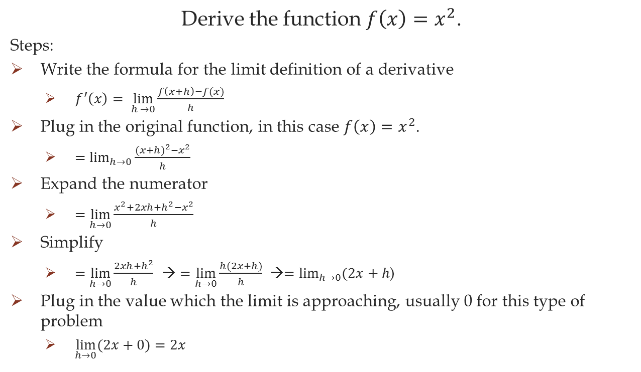
Example for the Limit Definition of a Derivative:
Derive the function $f\left(x\right)=x^{2}$.
Steps:
Write the formula for the limit definition of a derivative
$f^{′}\left(x\right)= \lim_{h →0}{\frac{f\left(x+h\right)−f(x)}{h}}$
Plug in the original function, in this case $f\left(x\right)=x^{2}$.
$=\lim_{h→0}{\frac{{(x+h)}^{2}−x^{2}}{h}}$
Expand the numerator
$=\lim_{h→0}{\frac{x^{2}+2xh+h^{2}−x^{2}}{h}}$
Simplify
$=\lim_{h→0}{\frac{2xh+h^{2}}{h}}$ → $=\lim_{h→0}{\frac{h(2x+h)}{h}}$ →$\underset{h→0}{=lim}{(2x+h}$)
Plug in the value which the limit is approaching, usually 0 for this type of problem
$\lim_{h→0}{(2x+0})=2x$

Slide 6
Alternative Definition
The derivative of the function f at the point x = a is the limit
$f^{′}\left(a\right)=\lim_{x→a}{\frac{f\left(x\right)−f(a)}{x−a}}$
provided the limit exists.
Notice that this formula is close in composition to the slope formula
$m=\frac{y_{2}−y_{1}}{x_{2}−x_{1}}$

Slide 7
Example for the Alternative Definition:
Differentiate $f\left(x\right)= \sqrt{x}$ using the alternate definition, at point $x=a.$
Steps:
Write the alternative definition
$f^{′}\left(a\right)=\lim_{x→a}{\frac{f\left(x\right)−f(a)}{x−a}}$
Plug in the information you have
$=\lim_{x→a}{\frac{\sqrt{x}−\sqrt{a}}{x−a}}$
Rationalize the numerator
$=\lim_{x→a}{\frac{\sqrt{x}−\sqrt{a}}{x−a}}×\frac{\sqrt{x}+\sqrt{a}}{\sqrt{x}+\sqrt{a}}$ → $=\lim_{x→a}{\frac{x−a}{(x−a)(\sqrt{x}+\sqrt{a})}}$ → $=\lim_{x→a}{\frac{1}{\sqrt{x}+\sqrt{a}}}$
Now take the limit
$=\lim_{x→a}{\frac{1}{\sqrt{a}+\sqrt{a}}}$ → $\frac{1}{2\sqrt{a}}$

Slide 8
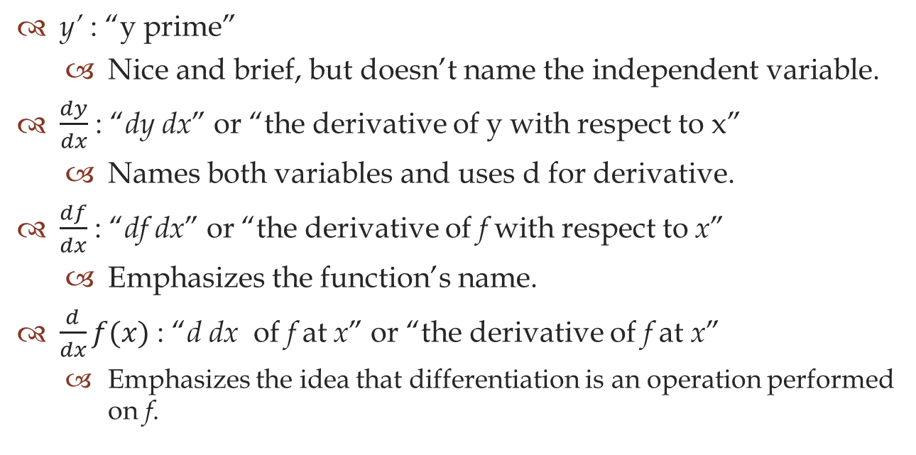
Different Derivative Notation
y’ : “y prime”
Nice and brief, but doesn’t name the independent variable.
$\frac{dy}{dx}$ : “dy dx” or “the derivative of y with respect to x”
Names both variables and uses d for derivative.
$\frac{df}{dx}$ : “df dx” or “the derivative of f with respect to x”
Emphasizes the function’s name.
$\frac{d}{dx}f(x)$ : “d dx of f at x” or “the derivative of f at x”
Emphasizes the idea that differentiation is an operation performed on f.

Slide 9
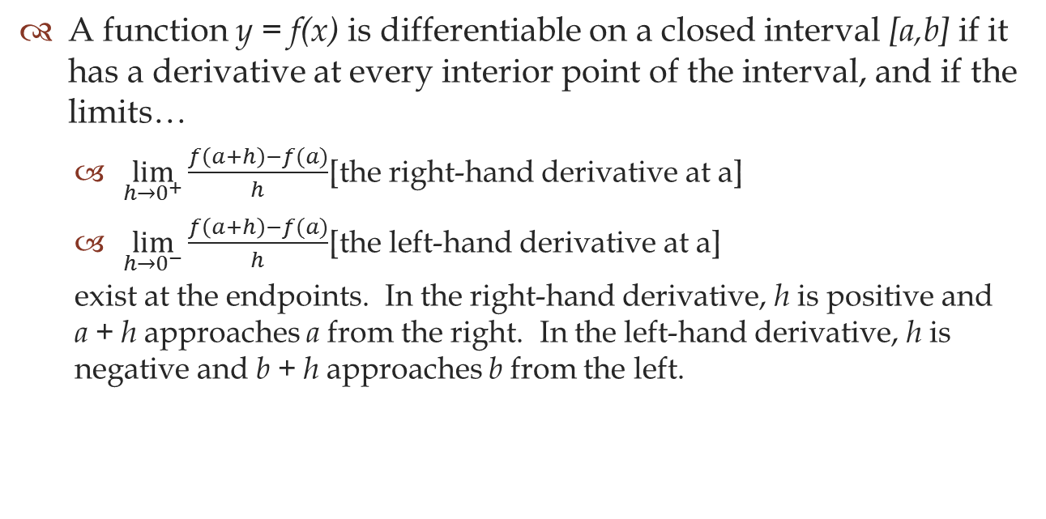
One-Sided Derivatives
A function y = f(x) is differentiable on a closed interval [a,b] if it has a derivative at every interior point of the interval, and if the limits…
$\lim_{h→0^{+}}{\frac{f\left(a+h\right)−f(a)}{h}}$[the right-hand derivative at a]
$\lim_{h→0^{−}}{\frac{f\left(a+h\right)−f(a)}{h}}$[the left-hand derivative at a]
exist at the endpoints. In the right-hand derivative, h is positive and a + h approaches a from the right. In the left-hand derivative, h is negative and b + h approaches b from the left.

Slide 10
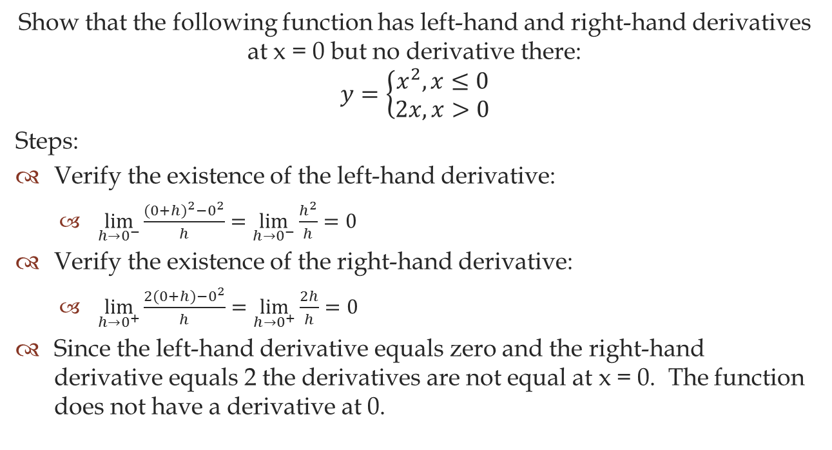
Example of one-sided derivatives:
Show that the following function has left-hand and right-hand derivatives at x = 0 but no derivative there:
$$y=\left\{\begin{matrix}x^{2}, x≤0 \\ 2x, x>0\end{matrix}\right.$$
Steps:
Verify the existence of the left-hand derivative:
$\lim_{h→0^{−}}{\frac{{(0+h)}^{2}−0^{2}}{h}=\lim_{h→0^{−}}{\frac{h^{2}}{h}=0}}$
Verify the existence of the right-hand derivative:
$\lim_{h→0^{+}}{\frac{2(0+h)−0^{2}}{h}=\lim_{h→0^{+}}{\frac{2h}{h}=0}}$
Since the left-hand derivative equals zero and the right-hand derivative equals 2 the derivatives are not equal at x = 0. The function does not have a derivative at 0.

