Slide 1
Parents’ Take on the CMS Retake Policy
Alexandra Corbett, Kayla McMillan, Karen Wang, Robert Gambill, Tylar Dunham

Slide 2
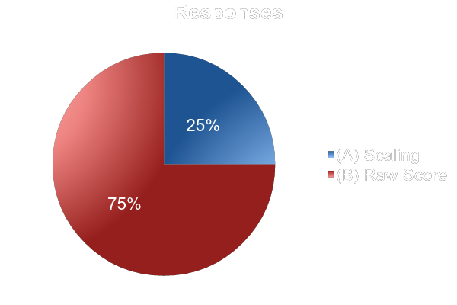
Which method of grading would you prefer teacher use for retests?
(A) Scaling the student's score to an 84% scale (a 100 yields an 84, a 90 yields a 75.6, an 80 yields a 67.2, etc.)
(B) allowing the highest score to be an 84, but not interfering with scores lower than an 84 and instead giving them the raw score (a 100-84 will yield an 84, an 80 will yield an 80, a 70 will yield a 70, etc.)

Slide 3
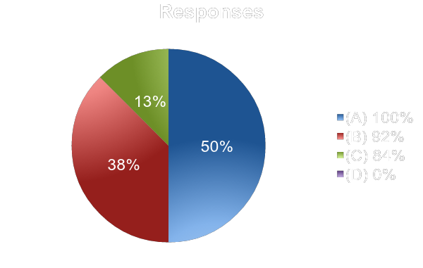
What do you think the maximum score on a retake should be?
(A) 100%
(B) 92%
(C) 84%
(D) 0%, retakes should not be allowed

Slide 4
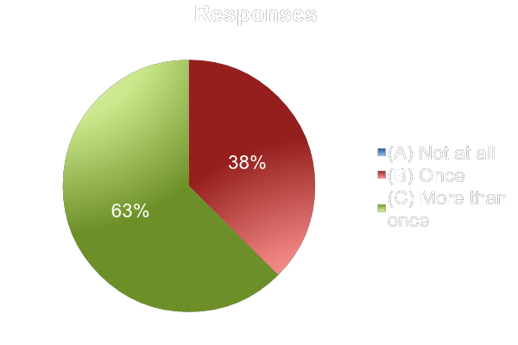
How often should students be allowed to retake?
(A) Not at all
(B) Once
(C) More than once

Slide 5
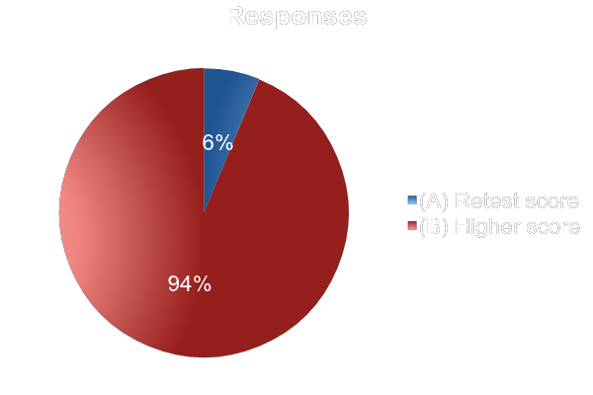
Should the retest score or the higher score between the two tests count?
(A) Retest score
(B) Higher score between the two tests

Slide 6
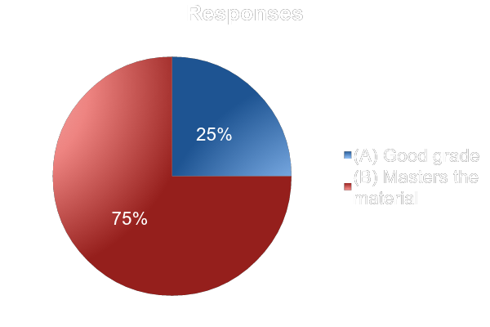
Is it more important that your child gets a good grade or masters the material?
(A) Good grade
(B) Masters the material

Slide 7
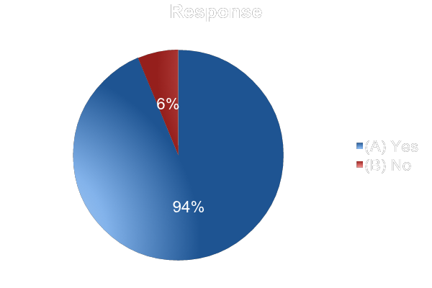
Should teachers take personal circumstances into account?
(A) Yes
(B) No

Slide 8
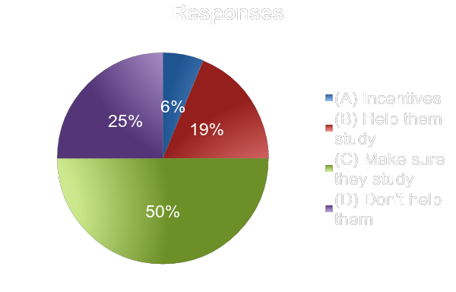
How do you help your child prepare for tests?
(A) I give them incentives
(B) I help them study
(C) I make sure they study
(D) I don’t help them prepare

Slide 9
Problems with the Survey
This survey consisted of entirely volunteered responses. This means that the data will be biased, because only the people that wanted to answer the questions answered them.
This means that it is likely that we did not get responses from:
Parents that are busier
Parents that don’t listen to the entire Connect-Ed messages
Parents that are less involved in their child’s/children’s school
Less patient parents
Some of the parents may not have understood the math behind the two different retake grading policies.

Slide 10
Conclusion
Based off of the questions, mainly 1-6, it appears that most parents want what is best for their child’s grade, even if that is not always what is fair.
Despite this, a greater percentage of parents who responded said that it was more important that their child mastered the material than it was that their child got a good grade.

