Slide 1
Teacher Responses to Survey on Retake Policy
Nick Kakavitsas, Molina Niphol, Peter Park, Gillian South, Kelly Williams
Notes:
Good things to say: We have reviewed the teachers responses and plan to show you the results and what they may mean.

Slide 2
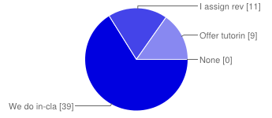
What kind of review or test prep did you assign your students to do in class?
We do in-class review- 66%
I assign review sheets- 19%
Offer tutoring- 15%
None- 0%
Notes:
Good things to say: Read question As you can see, all teachers do offer some sort of preparation for their students which indicates that they care about how well their students do on the test, however the result of this question does not point to what grading method the school should adopt.

Slide 3
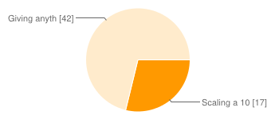
Which method of grading do you use on retests?
Scaling a 100% equal to an 84%. For example: 100% = 84%, 90% = 75.6%, etc.
29%
Giving anything greater than an 84%, an 84%. For example: 100% = 84%, 90% = 84%, etc.
71%
Notes:
Good things to say: Read question This question cut straight to the chase about which method of grading teachers use and the results seem to show that almost 3/4 of the teachers favor the moderate grading method. This, by itself, doesn’t show that the moderate method is the best method of grading. The next questions show why most teachers chose the moderate grading method. The “why” is important because if there is truly good reason behind the teachers choices, then the moderate method, being chosen by the majority of teachers, is the method that should be adopted by North Meck.

Slide 4
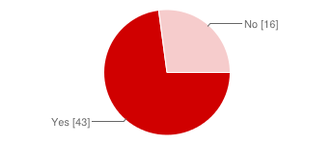
Do you take into account personal circumstances?
Yes- 73%
No- 27%
Notes:
Good things to say: Read Question The result of this question shows that many teachers are willing to go to great lengths to ensure their students’ success.

Slide 5
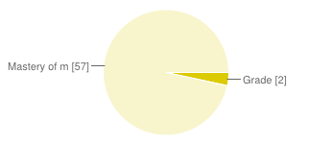
Do you think a student's grade or mastery is more important?
Grade- 3%
Mastery of material- 97%
Notes:
Good things to say: Read question The result of this question certainly shows that teachers are choosing the grading method they use for the right reason. If teachers were more concerned with grades than mastery, students might graduate with all A’s and no knowledge.

Slide 6
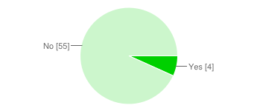
Do you think a retake policy prepares students for the real world/college?
Yes- 7%
No- 93%
Notes:
Good things to say: Read Question Although this question further proves the good intent of teachers, it doesn’t show “why” the teachers chose whichever grading method because the answers suggest that most teachers think that the CMS retest policy in general doesn’t prepare students for college. This means that if there was a third option to have no retest allowed, some teachers might have chosen that option.

Slide 7
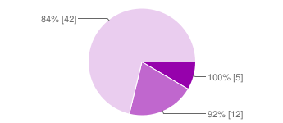
What do you think the max score on a retake should be?
100%- 8%
92%- 20%
84%- 71%
Notes:
Good things to say: Read question Most teachers chose the 84% maximum, which is the lowest of these options, and that backs up the result to the previous question. They both show that many teachers do not think retests prepare students for college and so they chose the lowest grade to demonstrate their opinion.

Slide 8
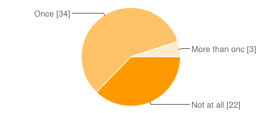
How many times do you think a student should be allowed to retake?
Not at all- 37%
Once- 58%
More than Once- 5%
Notes:
Good things to say: Read question The answers to this question show that more than a third of teachers do not agree with the current CMS retest policy. This makes the results of the past two questions make more sense.

Slide 9
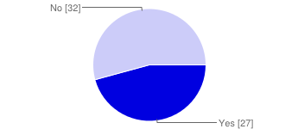
Does the pace of your class/course affect how you grade retests?
Yes- 46%
No- 54%
Notes:
Good things to say: Read question The result of this question is interesting because it is almost a 50/50 tie which hasn’t happened in the previous questions. This may mean that the question is a bad question because it doesn’t support the answers to the other questions in the survey.

Slide 10
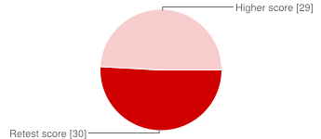
Should the retest score or the higher score count?
Retest Score- 51%
Highest Score- 49%
Notes:
Good things to say: Read question As with the last question, this result may be skewed which brings us to possible discrepancies in the process.

Slide 11
Possible Discrepancies in the Process of Receiving Data
Voluntary Response Bias: Only 59 teachers participated in the survey
Question Wording: The wording of questions may influence answers
Notes:
Good things to say: Voluntary Response Bias: We only got about 55% of teacher participation. Because of this, the data may not accurately represent teachers’ opinions on the retake policy at North Meck. Question Wording: the last two questions we showed may be examples of this bias. If we were to do over this survey, we would probably have a larger sample size and examine certain questions more carefully.

Slide 12
What Does This Mean?
Overall, teachers generally favor the moderate retake policy. The majority of teachers do their best to prepare their students for the test which shows that teachers care about their students and their scores. Many agree that retesting doesn’t prepare students for life after high school, which might be cause to bring up the retest policy with CMS.
Notes:
Good things to say: Read it

